Slide 1
Unmasking Blockchain
Joseph Cutrono
Ultimate Software

Slide 2
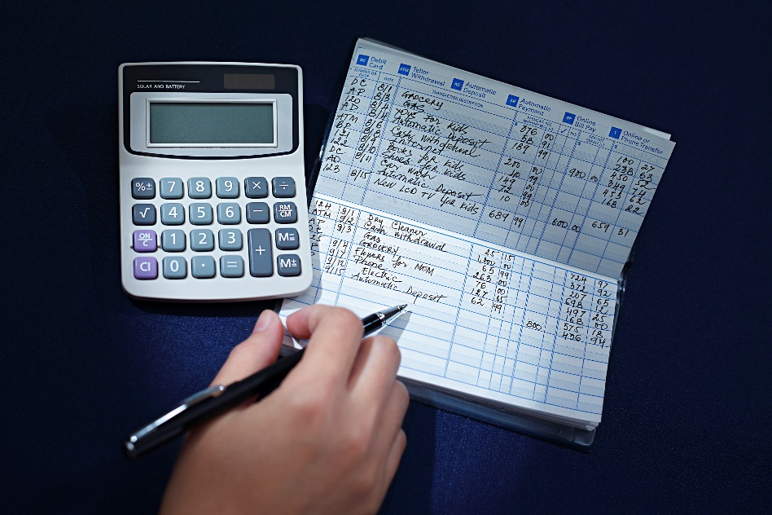
Terminology
Ledger
is the principal book or computer file for recording and totaling economic transactions measured in terms of a monetary unit of account by account type, with debits and credits in separate columns and a beginning monetary balance and ending monetary balance for each account.
Blockchain vs Distributed Ledger -> Xerox vs Copy
Hashing -> E365CD9C617713A54C6455F9D8998BA16E81E5078585F33A2DDCA8F03A3E8593

Slide 3
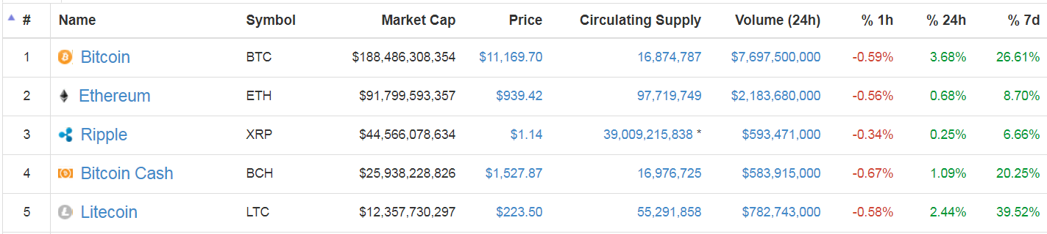
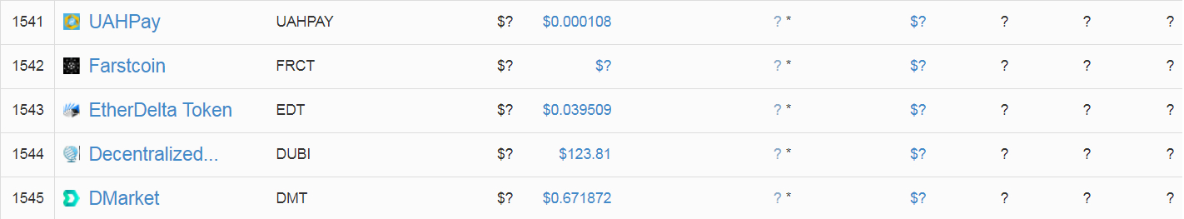
So which should I invest in… (smh)
~~~~~~~~~~~~~~~~~~~~~~~~~~~~~~~~~~~~~~~~~~~~~~~~~~~~~~~~~~~~~~~~~~

Slide 4
Example 1: Cryptocurrency
A naïve implementation

Slide 5
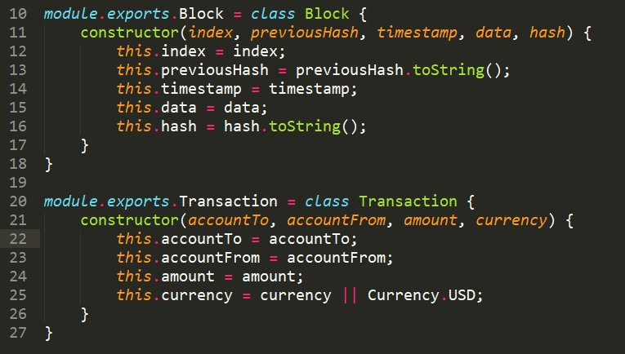
DDD approach for Cryptocurrency

Slide 6
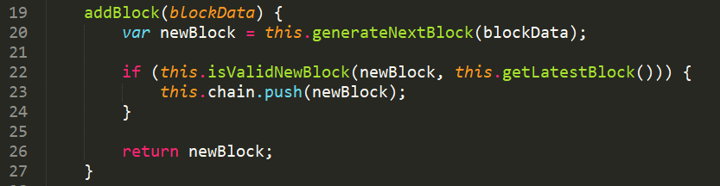
DDD approach for Cryptocurrency
addBlock – insert a new transaction

Slide 7
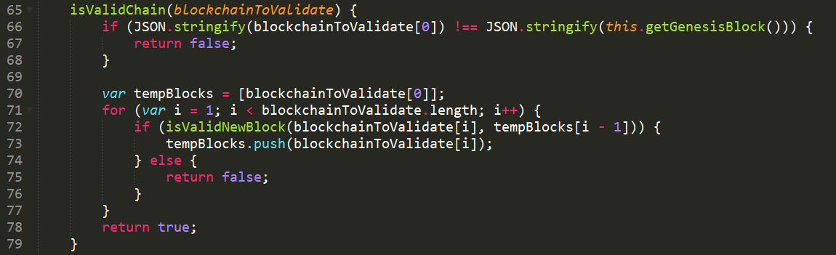
DDD approach for Cryptocurrency
validateChain – given the set of blocks, ensure we compute the same hash*
* Important to note we start at the beginning of the chain

Slide 8

3…2…1…ACTION

Slide 9
Example 2: Voting
Could it be…

Slide 10
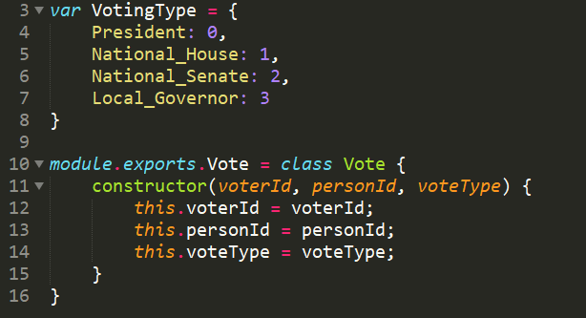
DDD approach for Voting

Slide 11
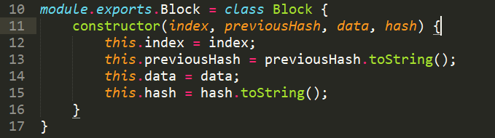
Ledger doesn’t change?

Slide 12
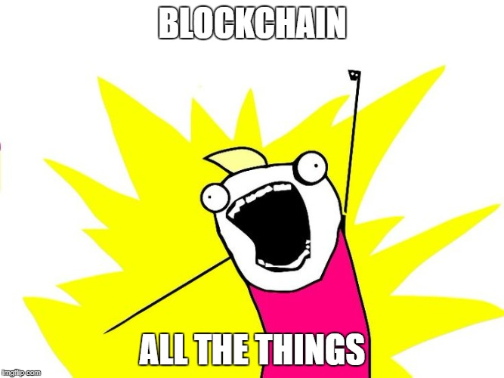
Blockchain – Do’s and Don’ts
It’s a magical rainbow with only gold at the end

Slide 13
When to use distributed ledgers
Yes
No
Power to the people
Data portability is paramount
Who did what
Proof of work is valuable
Believe in the power of good
Sole purpose of sharing data
All data is private
State > Transaction
Buy in (vs CRUD)
Because it’s the “cool” thing

Slide 14
Api Resources
https://blockchain.info/api
https://www.ethereum.org/greeter
https://developers.coinbase.com/
https://www.ibm.com/blockchain/platform/
http://fortune.com/2018/01/16/ibm-blockchain-maersk-company/
“The concern intends to help shippers, ports, customs offices, banks, and other stakeholders in global supply chains track freight as well as replace related paperwork with tamper-resistant digital records.”

Slide 15
Follow ups
http://lmgtfy.com/?q=parallelized+hashing
https://automationrhapsody.com/md5-sha-1-sha-256-sha-512-speed-performance
http://lmgtfy.com/?q=partial+proof+of+work
http://lmgtfy.com/?q=bitcoin+algorithm+computing+costs
$3,966
http://lmgtfy.com/?q=event+sourcing
http://lmgtfy.com/?q=bitcoin+mining+legislation
http://lmgtfy.com/?q=future+of+distributed+ledger+technology

Slide 16

Questions…
https://github.com/jcutrono/leanledger

